Slide 1



Environment Online User Guide
Set up and log in – Representing an entity using Digital Identity
Current as published on March 2024

Slide 2

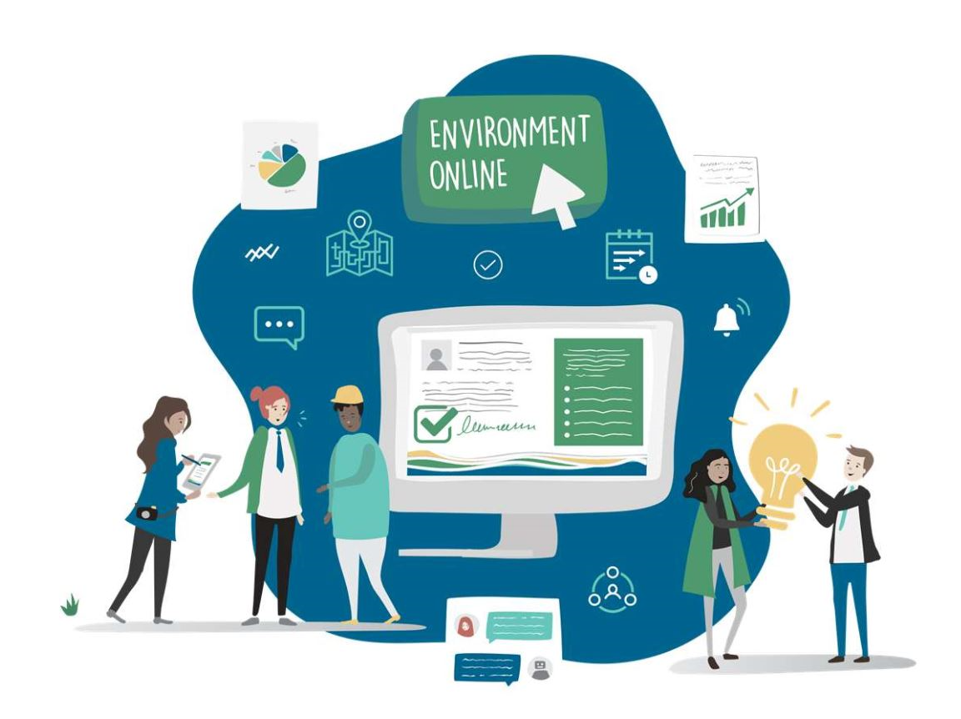
Contents
This guide provides information for organisations who want to use Digital Identity (e.g myID/WARAM) as the login method for Environment Online, and outlines what information is needed and how to navigate to the WA Relationship Authorisation Manager.
Contents
Log in overview
Representing an entity overview
Log in process
No authorisation to represent an entity
Step to log into EO – Representing an Entity
Environment Online Support

Slide 3



Log in overview
Environment Online is using Digital Identity (myID), and the WA Relationship Authorisation Manager (WARAM) to provide access to users.
The WA Government is using the Australian Government Digital Identity System to verify users for some services, including Environment Online (EO).
Digital Identity is a safe, secure and convenient way to prove your identity online. myID is a type of digital identity and is the Australian Government’s Digital identity app.
When you log in, EO ‘checks’ with myID to confirm your identity. This ensures your information is private and protected. Only a small amount of your information is passed to EO to prove your identity. This is limited to your name, email, and date of birth. Whilst your date of birth is shared it is not stored by EO.
Environment Online does not access any other personal information such as other services you use with your myID.
The WA Relationship Authorisation Manager (WARAM) manages authorisations that allow representatives to act on behalf of a business or person online.
Environment Online (EO) is using the WARAM to ensure only users that have been authorised by an entity, can transact on their behalf.
This can include acting on behalf of another person, a business or volunteer organisation.
Entities will use the WARAM to manage who can act on their behalf, providing them total control to protect their data and information.

Slide 4
Representing an entity overview
To represent a business or another entity e.g. a volunteer organisation or a sole trader, using Digital Identity, a person must have an authorisation in the WA Relationship Authorisation Manager (WARAM). More information can be found in the WA Relationship Authorisation Manager User Guide.
There are two types of authorisations;
Service Administrator:
  The initial Service Administrator is nominated by the business or organisation using the Authorisation Form. Subsequents are authorised by an existing Service Administrator.
  Can access online services on behalf of entities.
  Can manage authorisations for other users, invite a person to act on behalf of the business or other entity, either as another Service Administrator or as a Service User.
  Manages permissions in more detail within Environment Online, such as to specify functions or projects that others can access on behalf of the business/ entity (for example, to authorise different consultants to access different projects).
Service User:
  Must be authorised by an existing Service Administrator to act on behalf of the business, or organisation.
  Can access online services on behalf of entities.
  Only access the projects in Environment Online that have been specified by a Service Administrator.
Entity representation types
  Business/organisation: If you have not been authorised to act on behalf of a business, you can submit a request to obtain the necessary access in the WARAM. Please be aware that you may be asked to provide proof that you are allowed to act on behalf of the requested business. After a request has been submitted, it will be forwarded to any current Service Administrators for the business. If there are no Service Administrators, the request will be sent to the EO support team who will contact you for more information.
  Another person: You cannot request authority to act for another person, they must invite you to act on their behalf. Please contact the person to arrange for them to send you an invitation in the WARAM.

Slide 5

Log in Process
The diagram below shows the interactions of the different systems used to log into EO. You are automatically moved though each step of this process.
Representing
an entity
What you need:
A myID
Authorisation in the WARAM to represent an entity
Select represent an entity
Click log in
Log in using your myID
Select the entity you wish to represent
You are logged into Environment Online representing an entity
Create a myID if you don’t have one
Request authorisation to represent an entity if no entities are displayed

Slide 6
Steps to log into Environment Online if you do not have authorisation in the WARAM

Slide 7
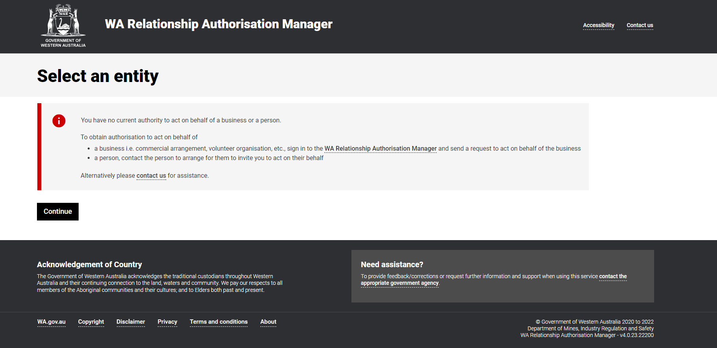

Representing an entity – no authorisation
No entity is displayed
If no entities are displayed it means that you do not have an authorisation in the WA Relationship Authorisation Manager (WARAM) to act on behalf of an entity in Environment Online.
You will need to request an authorisation from your Service Administrator in the WARAM to represent a business or organisation.
You cannot request authority to act for another person, they must invite you to act on their behalf. Please contact the person to arrange for them to send you an invitation in the WARAM.
To request an authorisation click the link to the WA Relationship Authorisation Manager – do not click continue.
Note: If there are no Service Administrators for your business please Contact Us - Environment Online

Slide 8
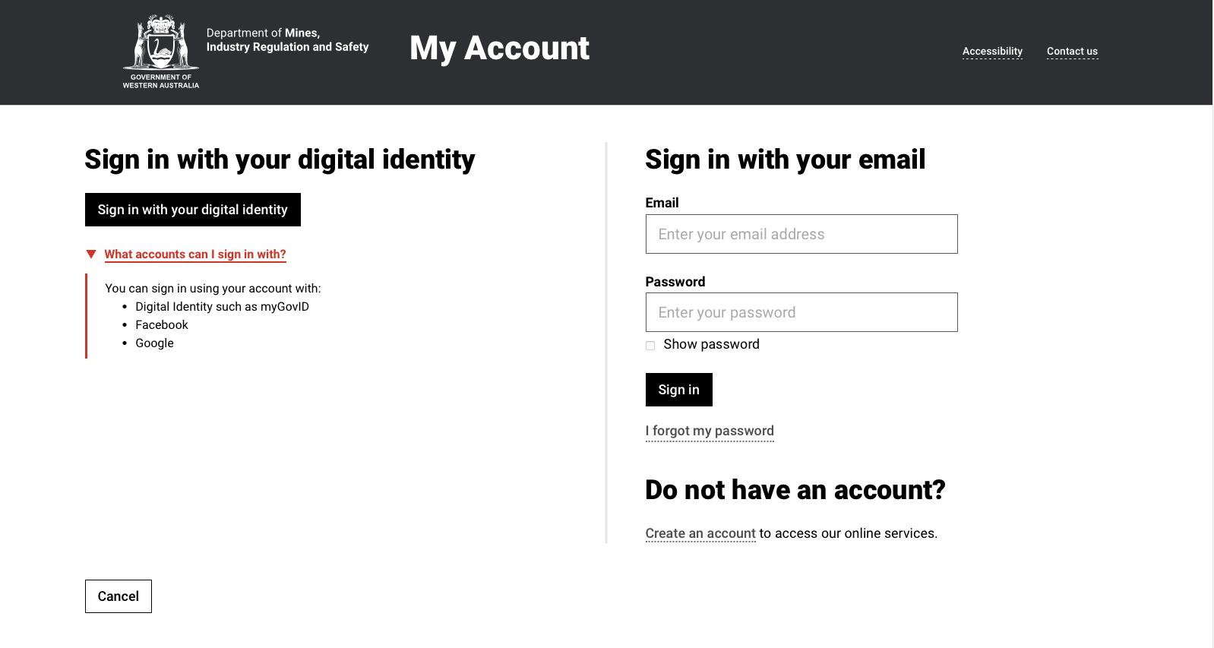
Representing an entity – no authorisation
Click Sign in with your digital identity.
Note: do not select any other option otherwise you will not be able to request access to Environment Online.

Slide 9
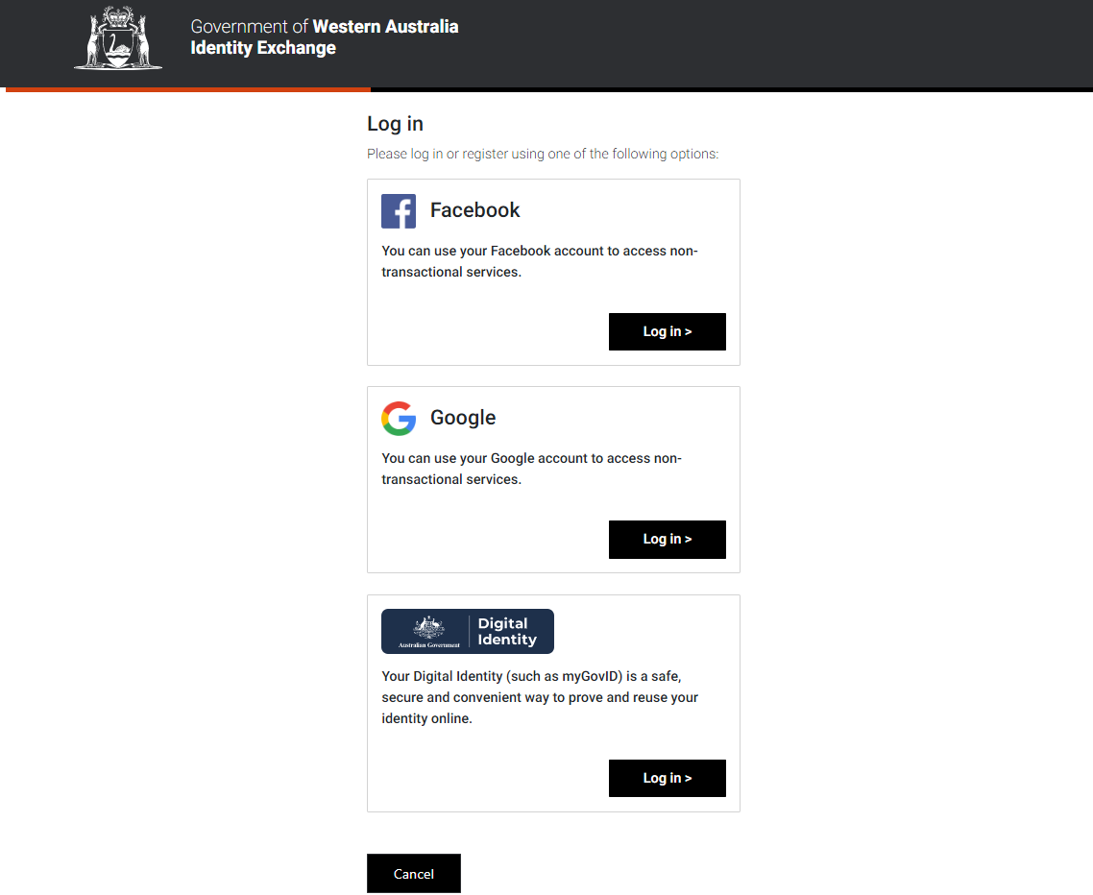
Representing an entity – no authorisation
Click Log in in the Digital Identity box.
Note: do not select any other option otherwise you will not be able to request access to Environment Online.

Slide 10
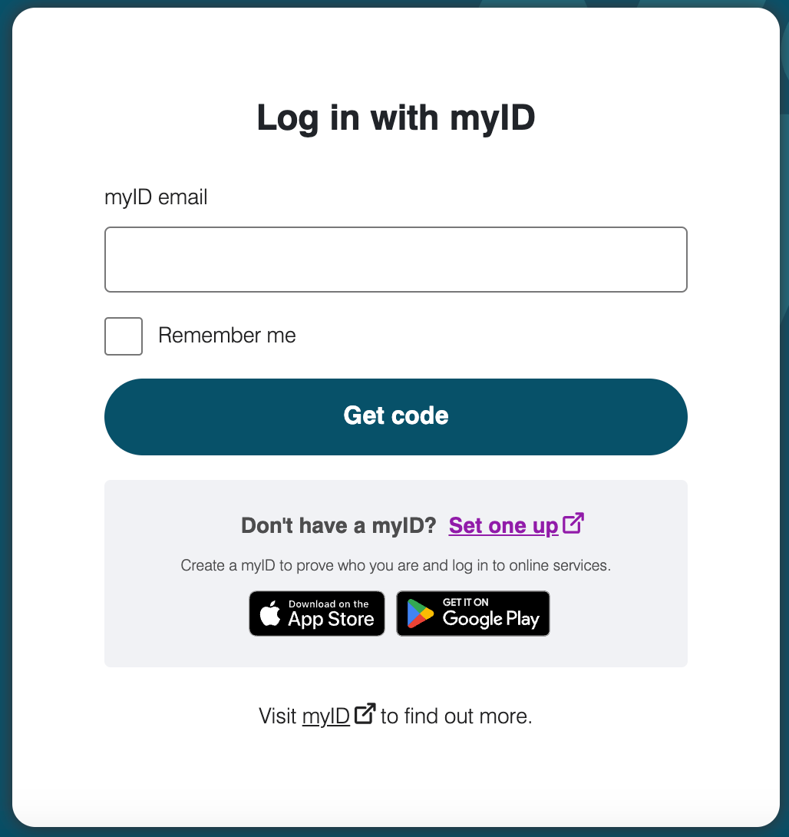
Representing an entity – no authorisation
If you already have a myID, enter the email address associated with your ID and click Login
If you do not have a myID – follow the steps to create one
How to set up | myID
  For help resolving issues creating a myID Digital Identity please visit the Help: Proving your identity | myID on the Australian Government’s Digital Identity website
When you log into EO you can update your contact email to be different to the one you use to log in with your myID. You can change your email contact in EO at anytime.
You will always enter the email associated with your myID to log in on this page. This may be different to your contact email in EO.
*This step is only for first time you log in

Slide 11
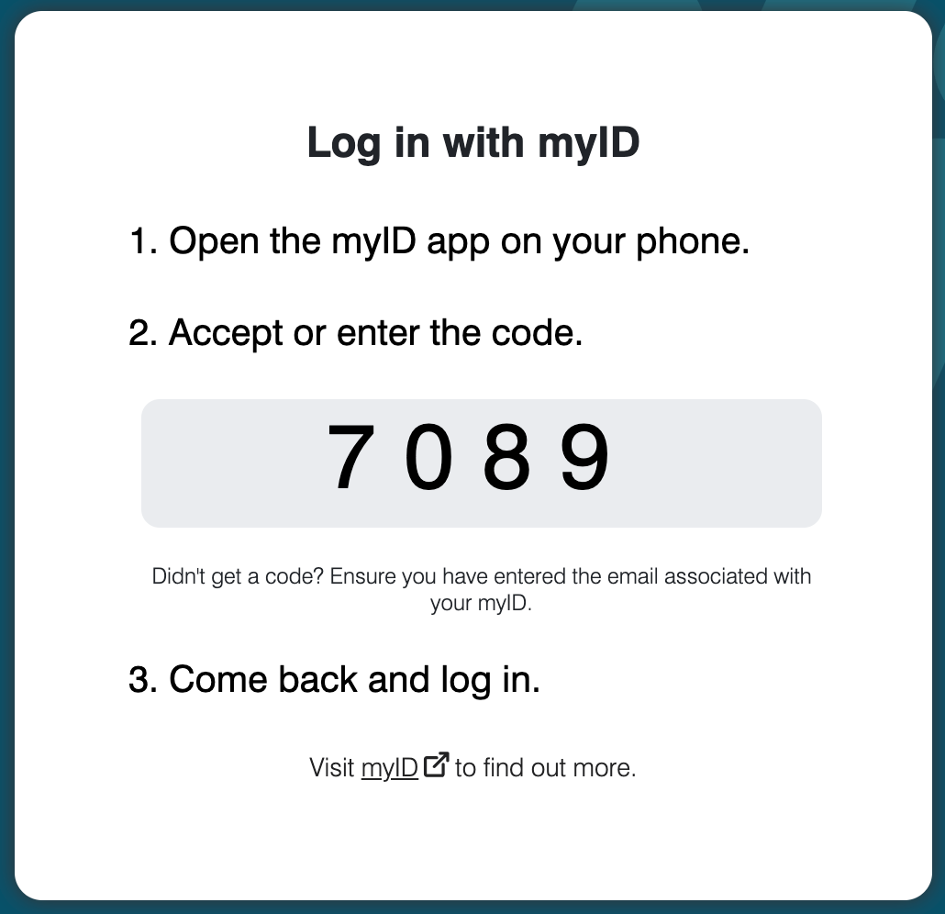
Representing an entity – no authorisation
Open the myID app on your smart device and enter the code that is displayed.
Note: Make sure you have the myID app downloaded on your smart device and you are connected to the internet.

Slide 12
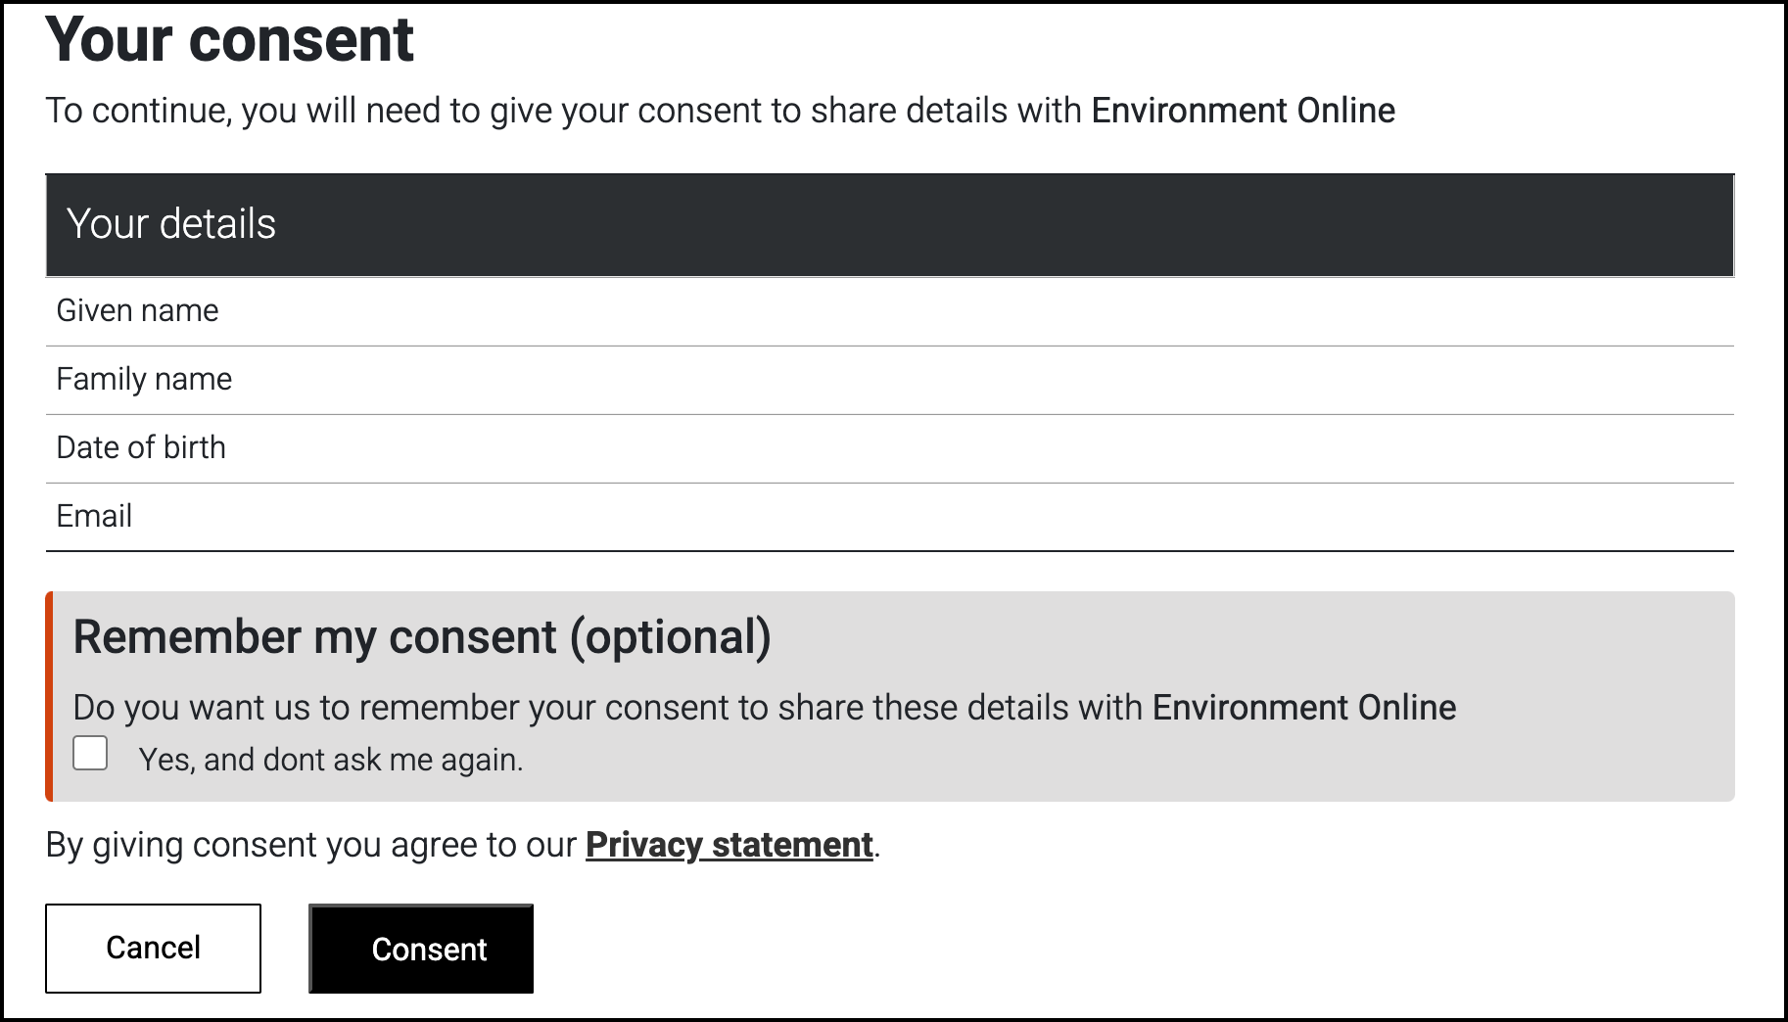
Representing an entity – no authorisation
We need your consent to share your name, date of birth and email addresses obtained from your myID, with the WA Identity Exchange.
These are the only details myID shares. No other information associated with your myID is provided.
If you give your consent for the details to be shared, click Consent
*This step is only for first time you log in

Slide 13
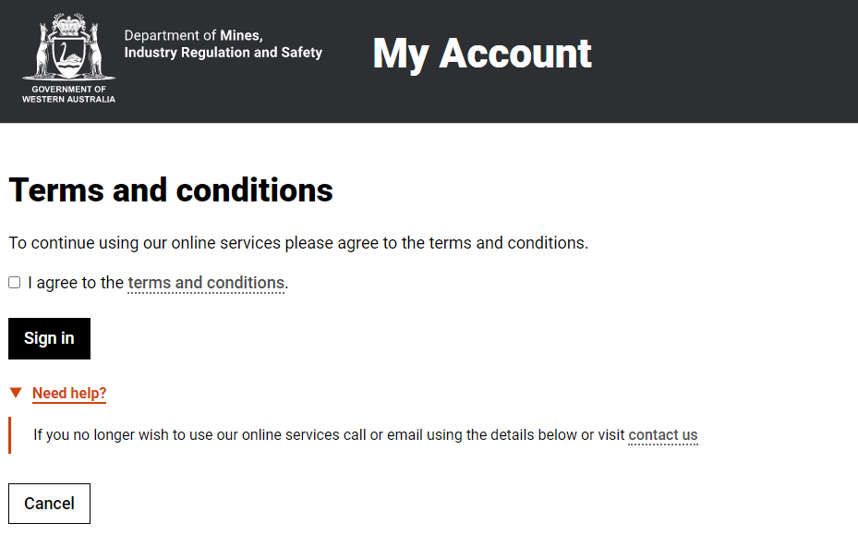
Representing an entity – no authorisation
You will need to agree to the terms and conditions to use the WARAM.
Click the tick box then click Sign in.

Slide 14
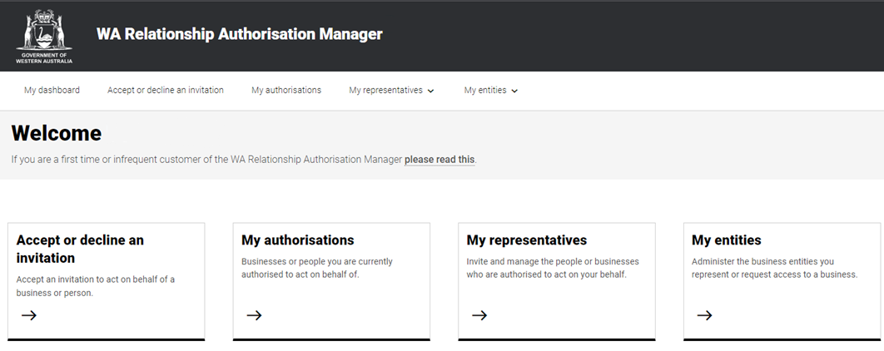
Representing an entity – no authorisation
You are now logged into the WARAM and can request authorisation to act on behalf of an entity.
The WARAM provides information about how to request authorisations in the
WARAM user guide – Requesting authorisation to act on behalf of a business
Once you have an authorisation, return to Environment Online and log in on behalf of an entity.

Slide 15
Steps to log into Environment Online if you already have authorisation in the WARAM

Slide 16
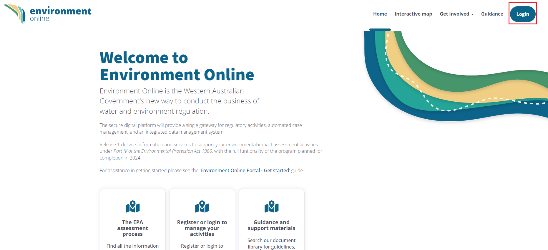
Representing an entity
To log into Environment Online click the Login button

Slide 17
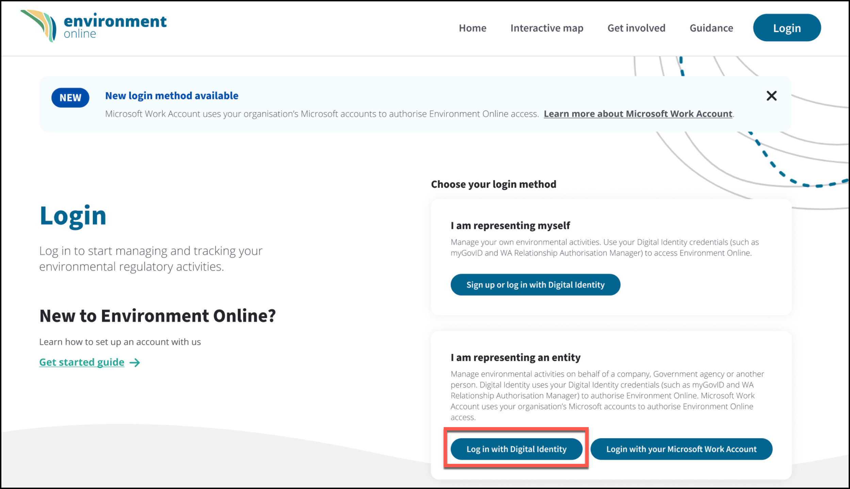
Representing an entity
Click Log in with Digital Identity under I am representing an entity

Slide 18
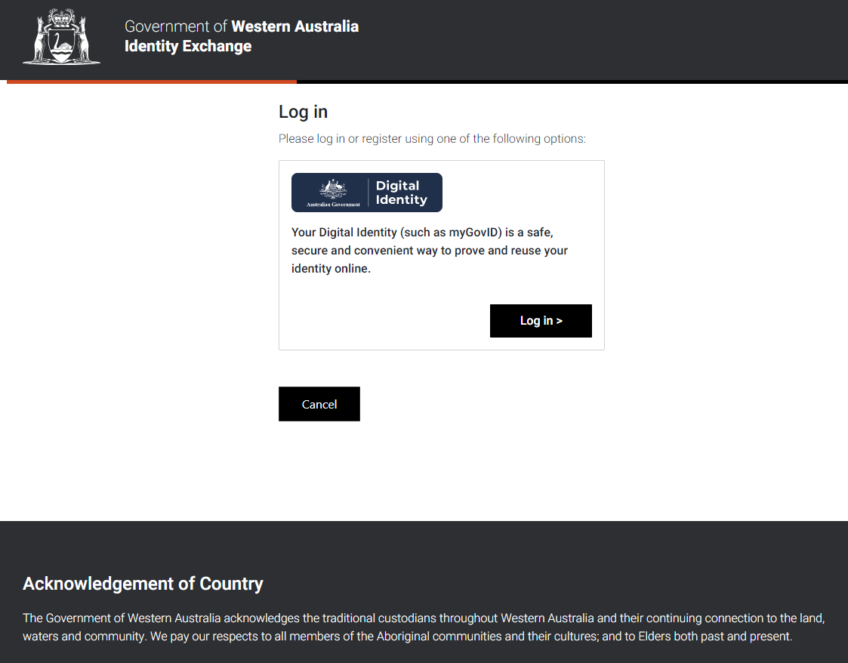
Representing an entity
Click Log in in the Digital Identity box

Slide 19
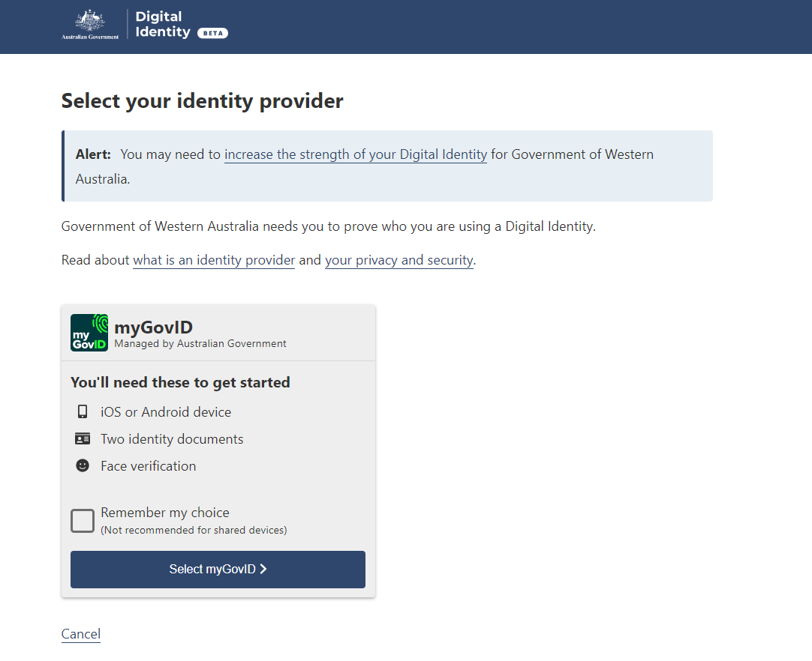
Representing an entity
Click on Select myID

Slide 20
Representing an entity
If you already have a myID, enter the email address associated with your ID and click Login
If do not have a myID – follow the steps to create one How to set up | myID
Note: When you log into EO you can update your contact email to be different to the one you use to log in with your myID. You can change your contact email in EO at anytime.
You will always enter the email associated with your myID to log in on this page. This may be different to your contact email in EO.

Slide 21
Representing an entity
Open the myID app on your smart device and enter the code that is displayed.
Note: Make sure you have the myID app downloaded on your smart device and you are connected to the internet.

Slide 22
Representing an entity
We need your consent to share your name, date of birth and email obtained from your myID with the WA Identity Exchange.
These are the only details myID shares. No other information associated with your myID is provided.
If you give your consent for the details to be shared, click Consent
*This step is only for first time you log in

Slide 23
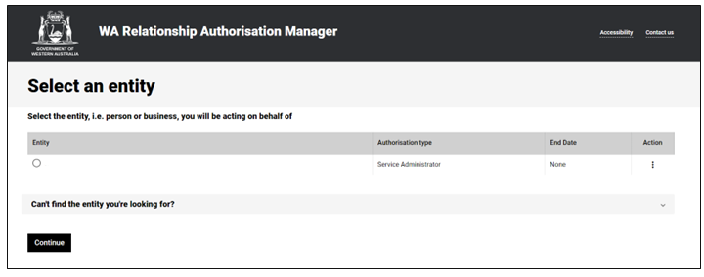
Representing an entity
Entity displayed
If you have an existing authorisation to act on behalf of an entity, you will be able to view the entity name.
No entity displayed
If you do not have an existing authorisation to act on behalf of an entity in the WARAM you will receive this error message.
Click here for instructions on how to request an authorisation

Slide 24
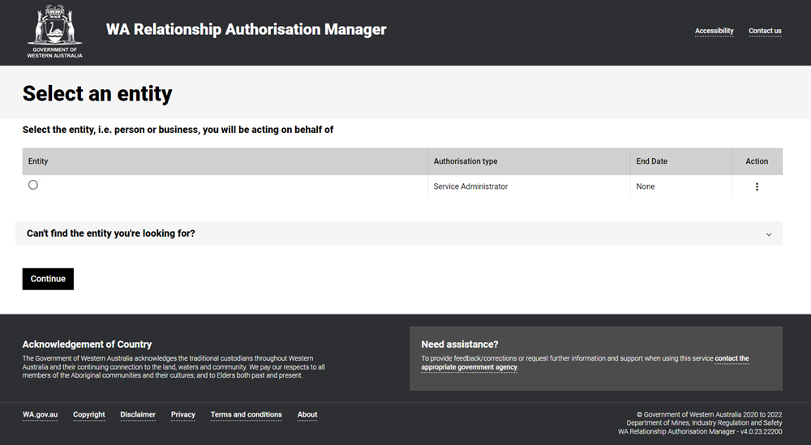
Representing an entity
Select the entity you want to represent. You may have multiple entities that you have authorisations to act on behalf of in EO.
Check the box next to the entity you want to represent, then click Continue

Slide 25
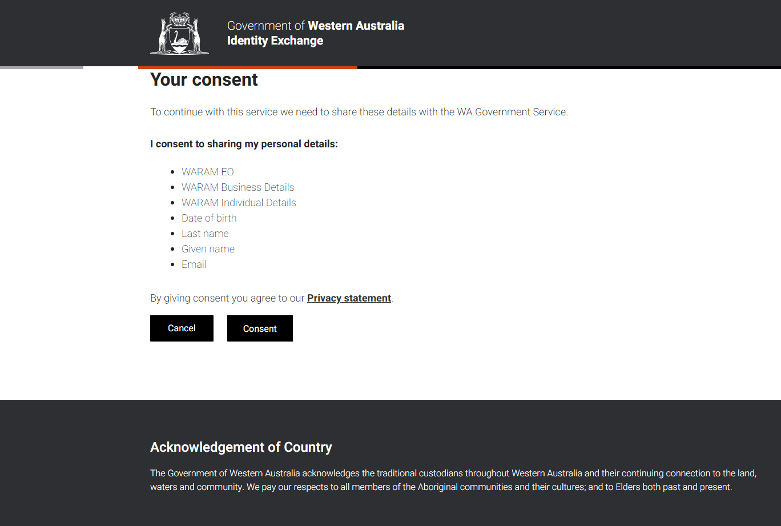
Representing an entity
We also need your consent to share your details obtained from the WA Identity Exchange with Environment Online.
These are the only details shared with Environment Online.
If you give your consent for the details to be shared, click Consent

Slide 26
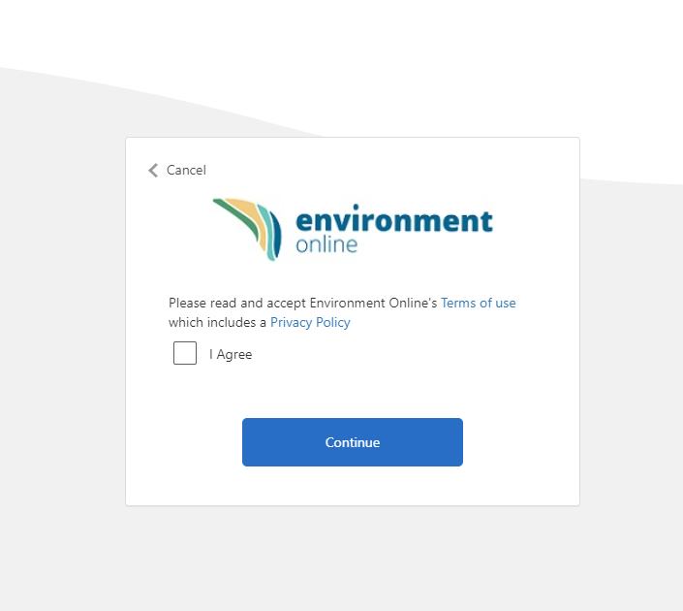
Representing an entity
To use Environment Online you must accept the terms of use which includes a privacy policy.
If you agree, click the tick box and click continue
*This step is only for first time you log in

Slide 27
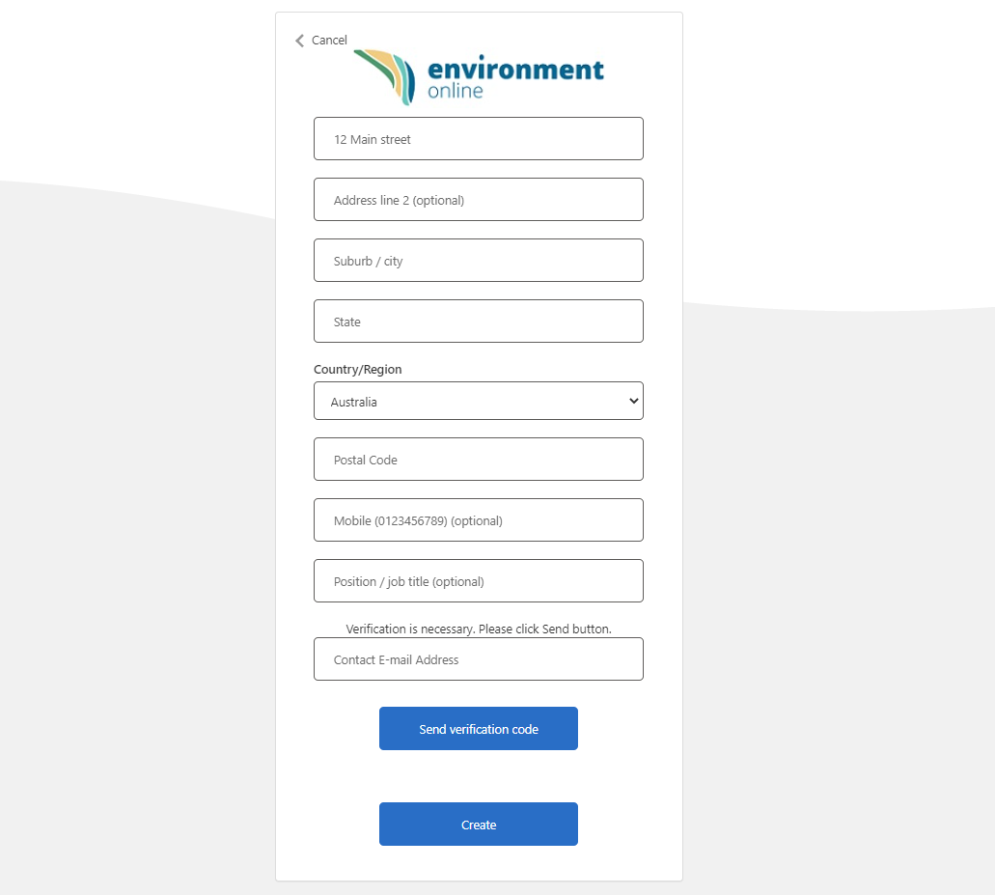
Representing an entity
Enter your contact details for Environment Online, including the email you wish to be contacted on. This email can be different to the one you use to log into your myID.
Click Send verification code.
An email will be sent to the email you entered with a verification code.
*This step is only for first time you log in

Slide 28
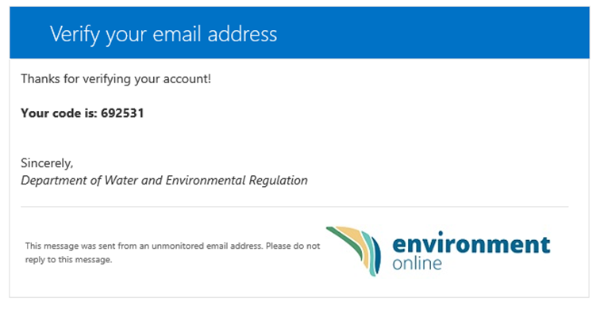
Representing an entity
Open the email received from Department of Water and Environmental Regulation.
Copy or note the code and return to Environment Online.
*This step is only for first time you log in

Slide 29
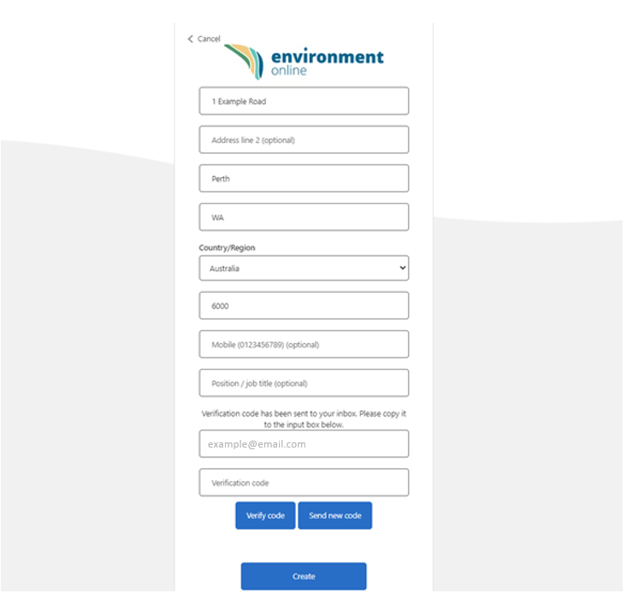
Representing an entity
Enter the code in the verification code box and click Verify code
Note: Do not click the create button straight away as it takes a second or two for the code to be verified.
*This step is only for first time you log in

Slide 30
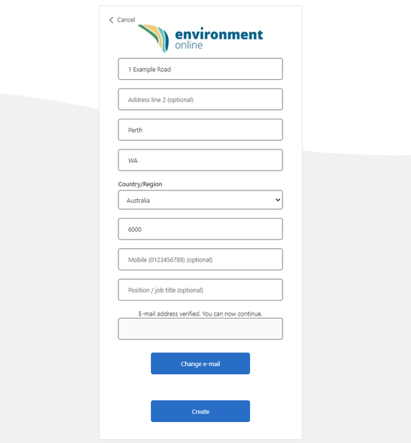
Representing an entity
Once the message changes to E-mail address verified, click Create
*This step is only for first time you log in

Slide 31
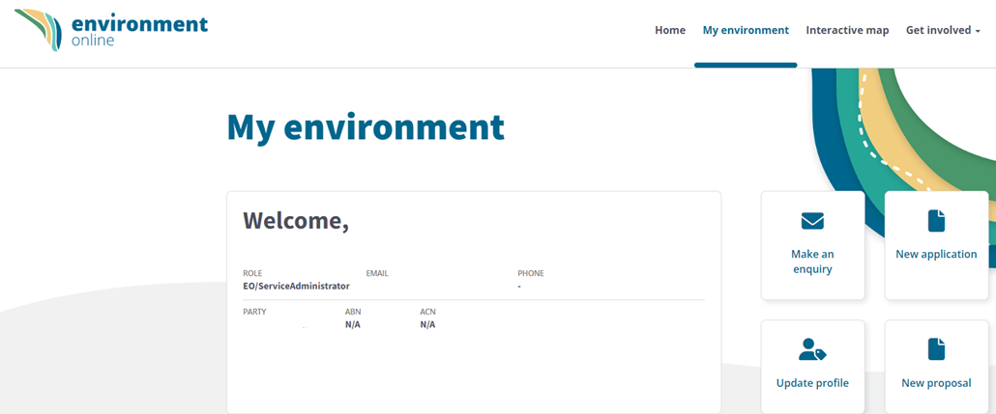
Representing an entity
You are now logged into Environment Online.

Slide 32






EO Support
Get Started Guide
Information about Environment Online including an overview of how to set up and log in to EO, and answers to frequently asked questions.
Environment Online – Get started
Contact EO Support for
Technical faults
System issues or bugs
WARAM access requests
Microsoft Work Account login access
Content updates
Functionality enquiries
Feedback
Guidance Materials
Quick reference guides and articles
Accessing EO - step by step guides
Policies and procedures
Can be viewed without logging in via
Environment Online
  Submit an online enquiry
  via Environment Online
  Use the ‘Enquire Online’ button anytime. We will respond during office hours
  Call us
  Phone: 1800 161 176
  Between 8.30am – 5pm Monday to Friday,
  or leave a message after hours

